Slide 1
NODE.JS
(The Backend Of MERN Stack)
Lecture 19

Slide 2
Today’s Agenda
Handling POST Request
Testing POST Request Using POSTMAN
Testing POST Request Using ThunderClient
Extracting POST Data
Performing Validation Using Joi
Exercises
Handling PUT Request
Handling DELETE Request
Project

Slide 3
Handling post request in express
The POST request is handled in Express using the post() method.
This is used when there is a requirement of fetching data from HTML FORMS.
The data sent through the POST request is stored in the request object

Slide 4
Exercise 41
WA Server to handle the post requests for “/login” and “/logout” route

Slide 5
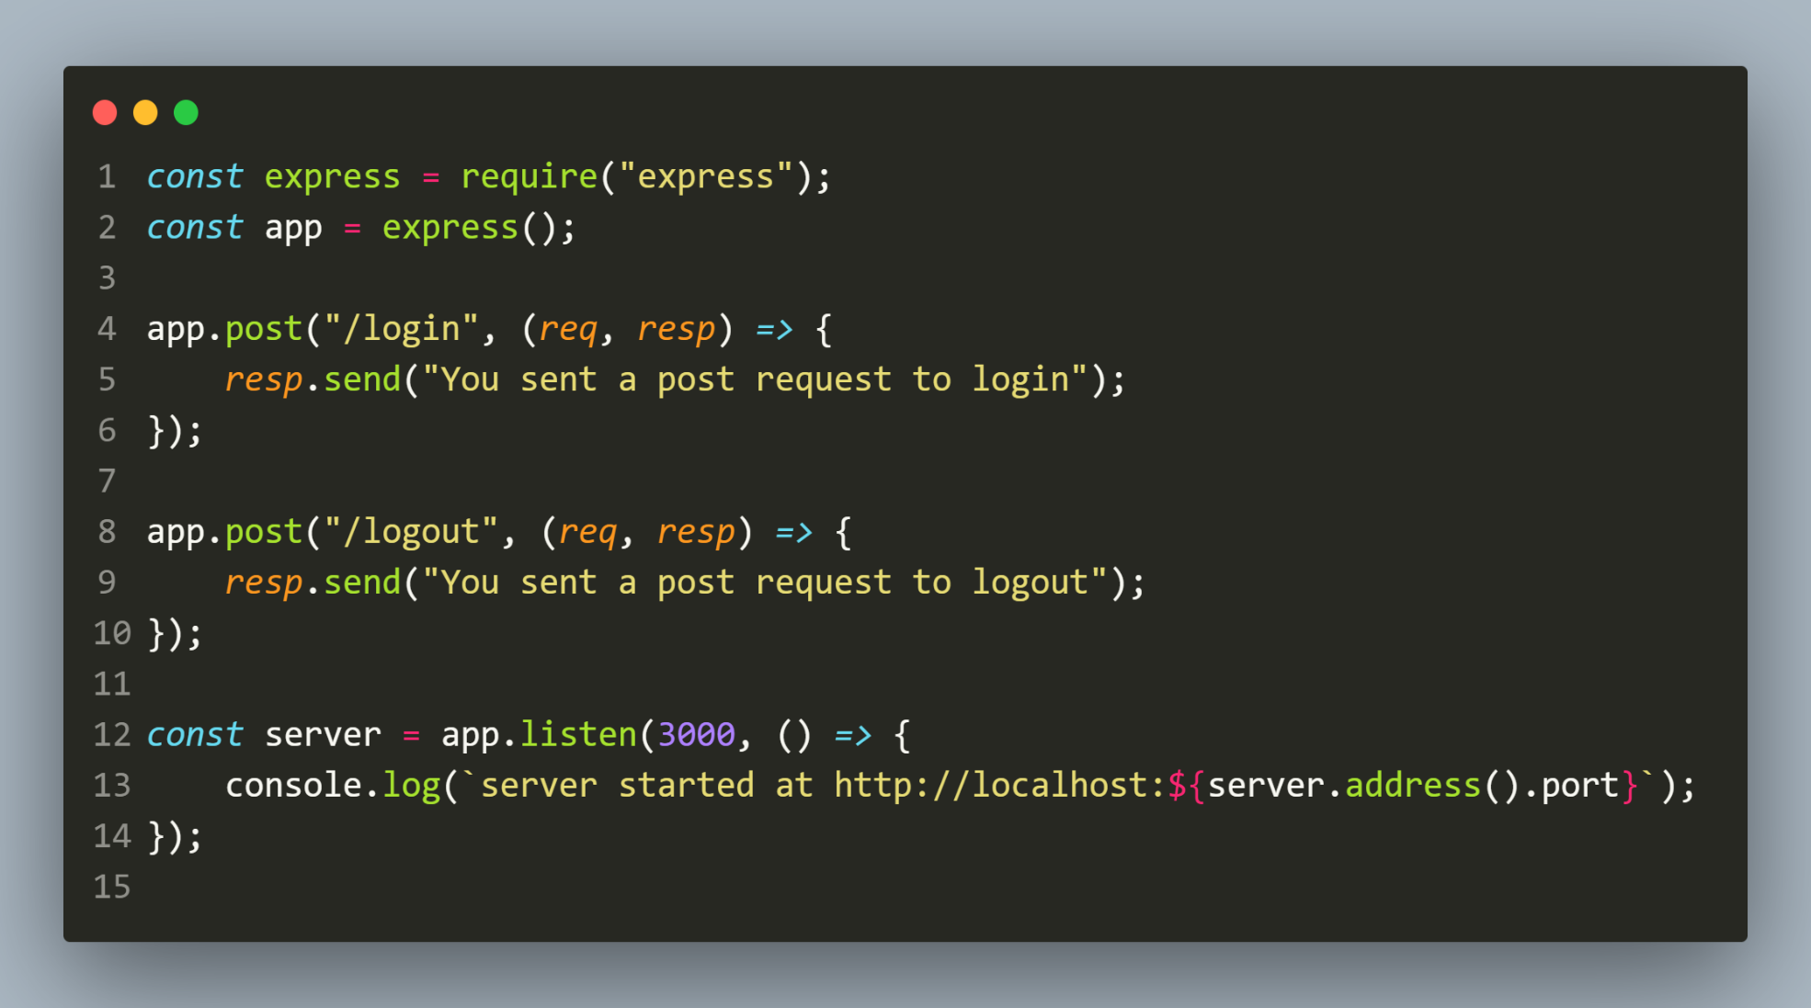
Solution
The code

Slide 6
How to test post request ?
For testing a POST request we require a REST API CLIENT like:
Postman
HoppScotch
ReqBin
ThunderClient extension for VS CODE

Slide 7
What is postman ?
Postman is an application used for API testing.
It is an HTTP client that tests HTTP requests, utilizing a graphical user interface, through which we obtain different types of responses that need to be subsequently validated. .

Slide 8
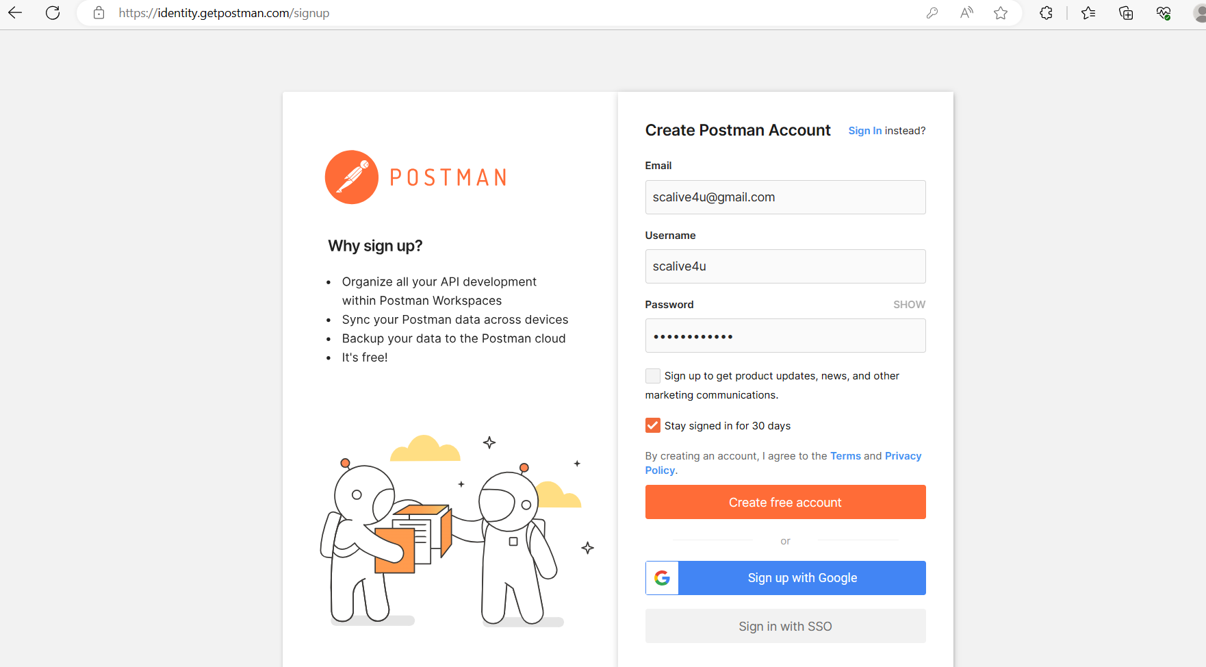
How to use postman ?
Create an account by visiting the following url https://identity.getpostman.com/signup

Slide 9
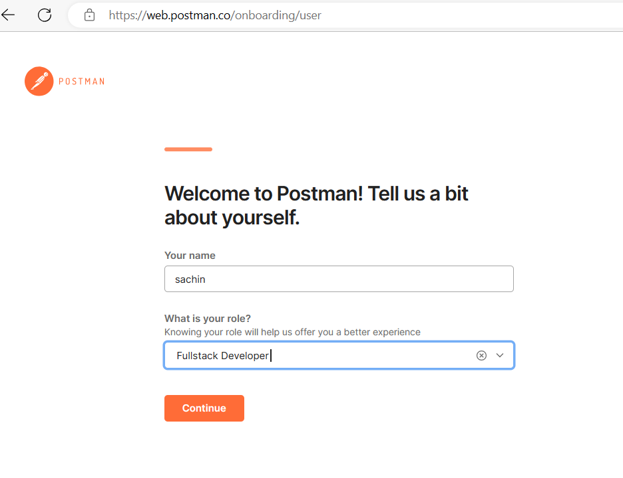
How to use postman ?
Fill the required details

Slide 10
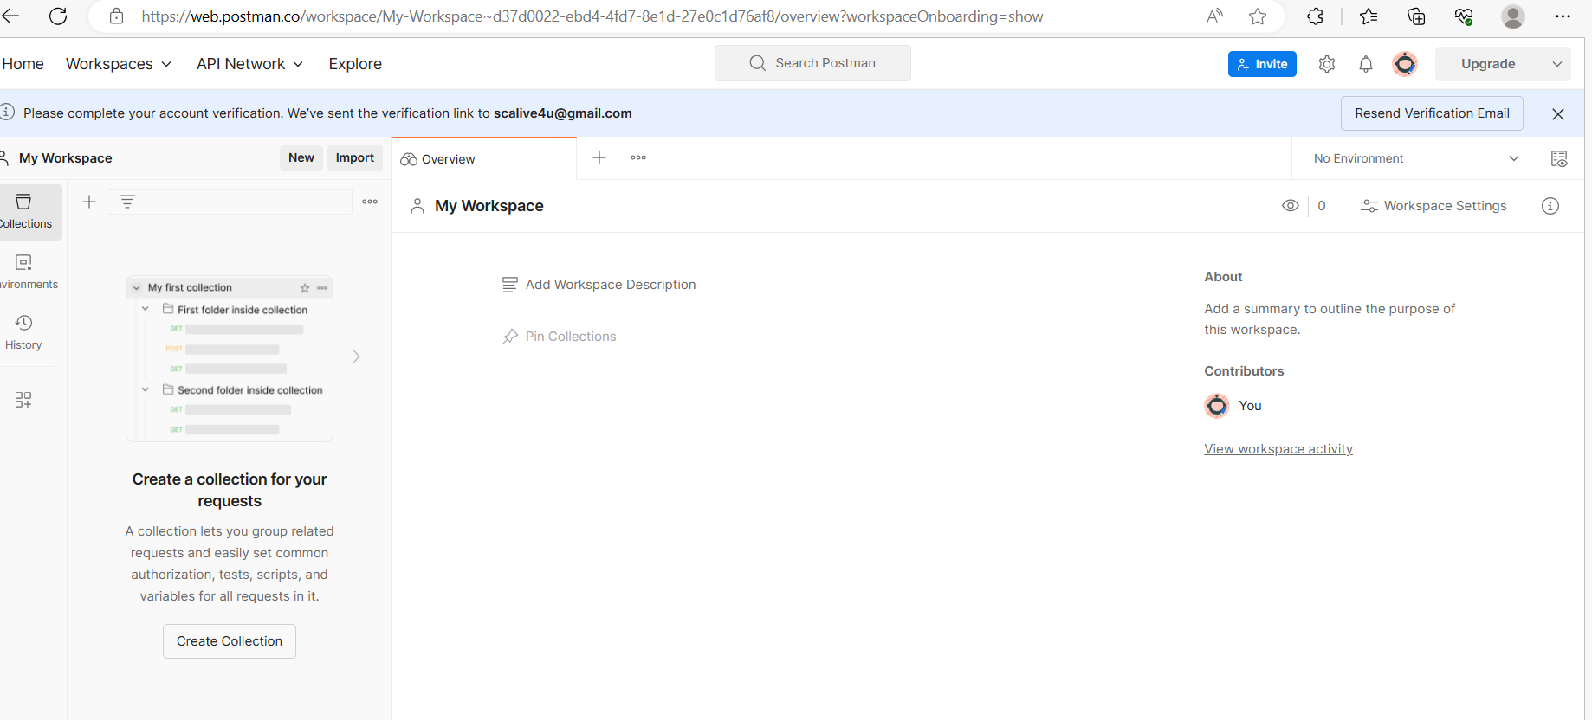
How to use postman ?
You will be redirected to your workspace

Slide 11
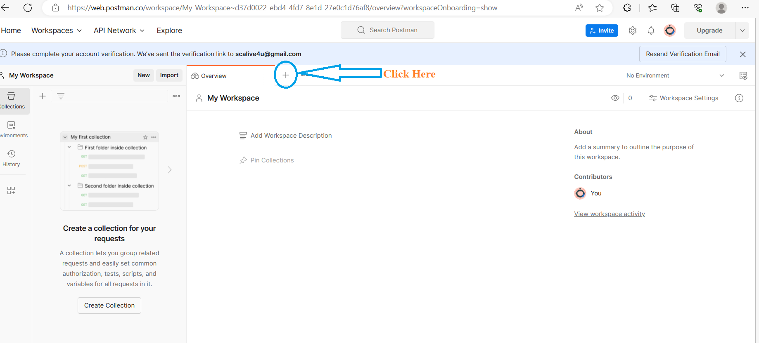
How to use postman ?
Click on the + symbol

Slide 12
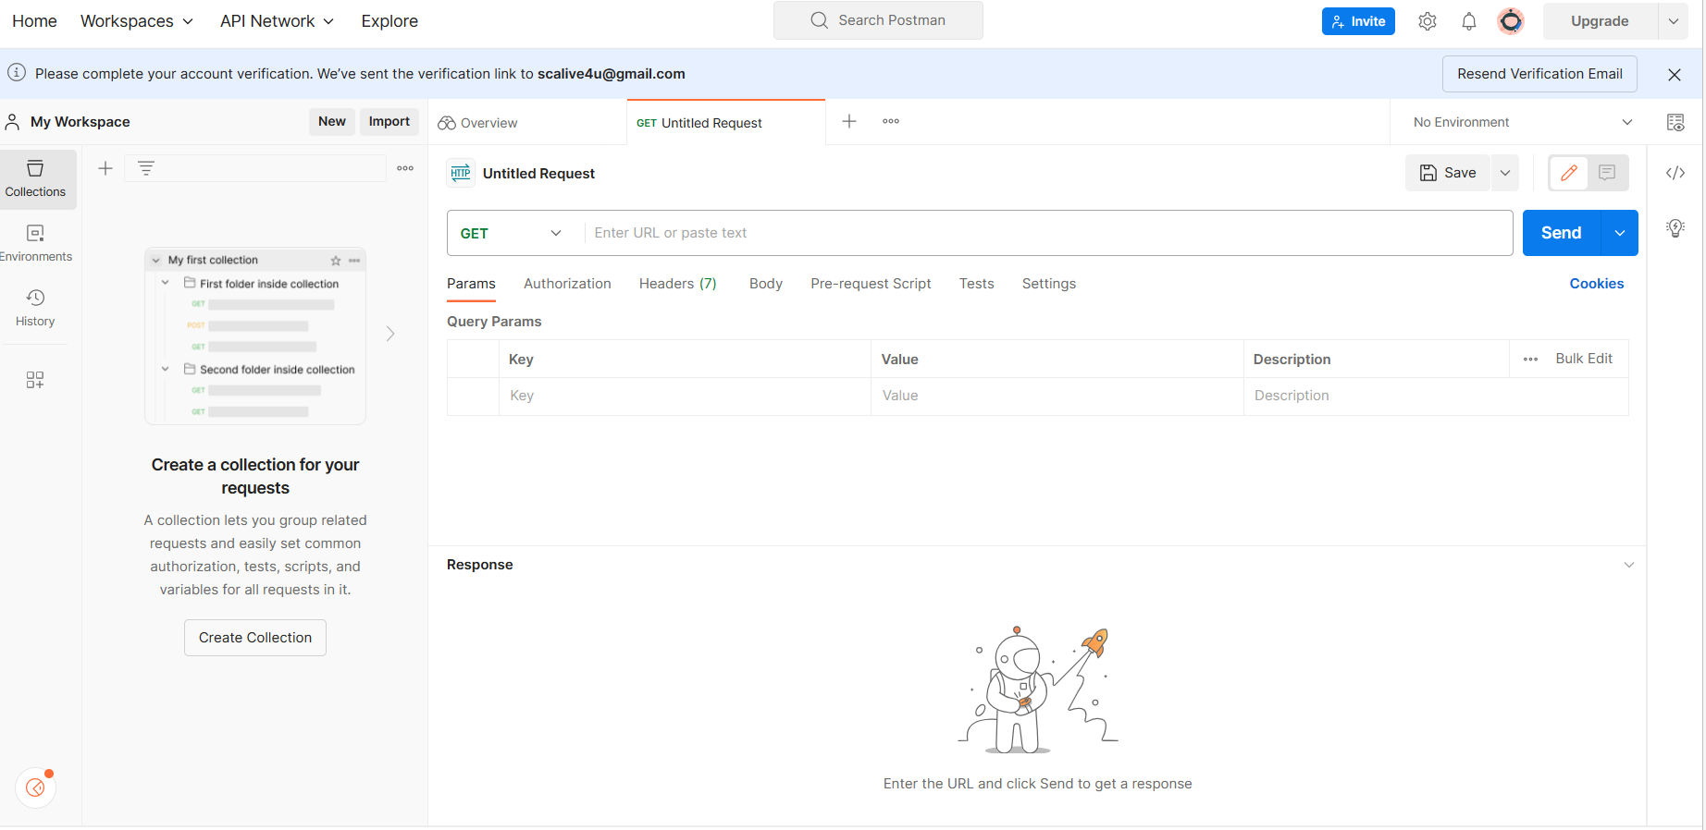
How to use postman ?
You will get an interface to type the URL and get the response

Slide 13
How to use postman ?
Go to VS CODE and start the server.
Come back to your browser window
Select POST from the dropdown
Type the url: http://localhost:3000/login
Click the Send button

Slide 14
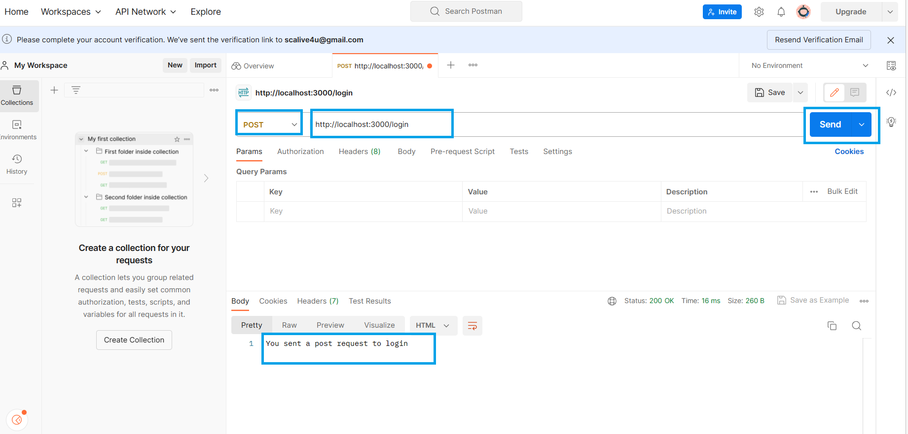
output

Slide 15
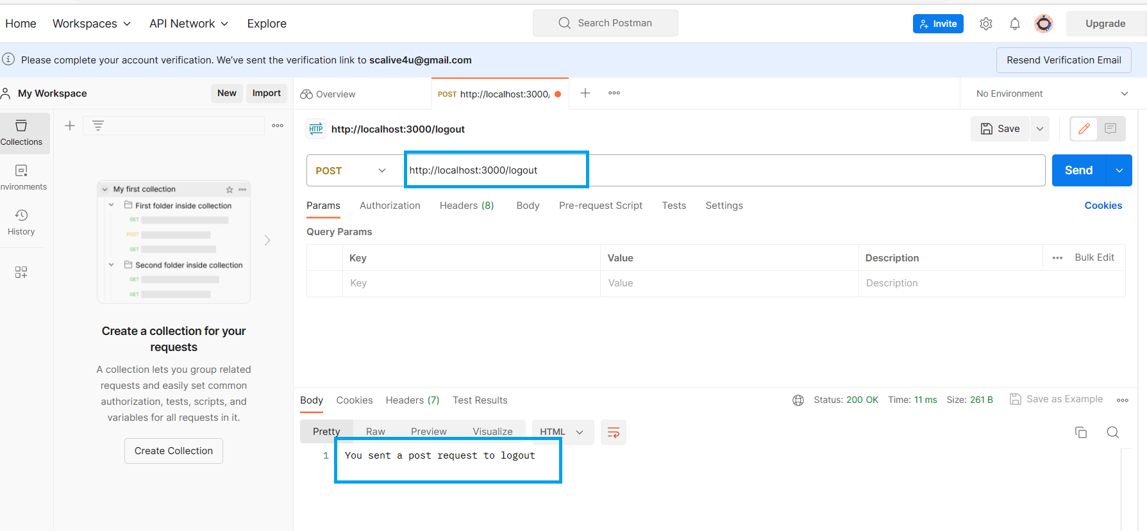
output

Slide 16
What is thunderclient ?
ThunderClient is a light weight API testing tool.
It is an extension developed for VS CODE
Has a simple to use GUI

Slide 17
Using thunderclient
Download the ThunderClient extension in VS Code
Click Thunder Client icon on the Action Bar.
From Sidebar click New Request button to test API

Slide 18
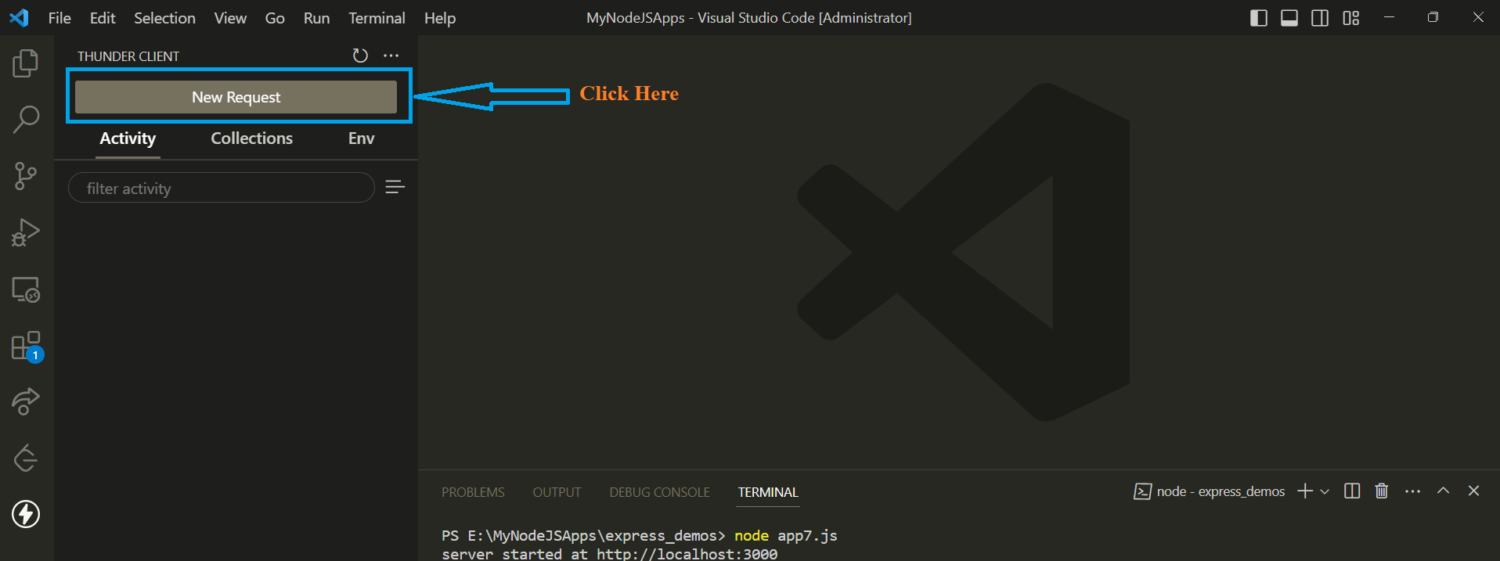
Using thunderclient

Slide 19
Using thunderclient
Select POST from the dropdown
Type the url: http://localhost:3000/login
Click the Send button

Slide 20
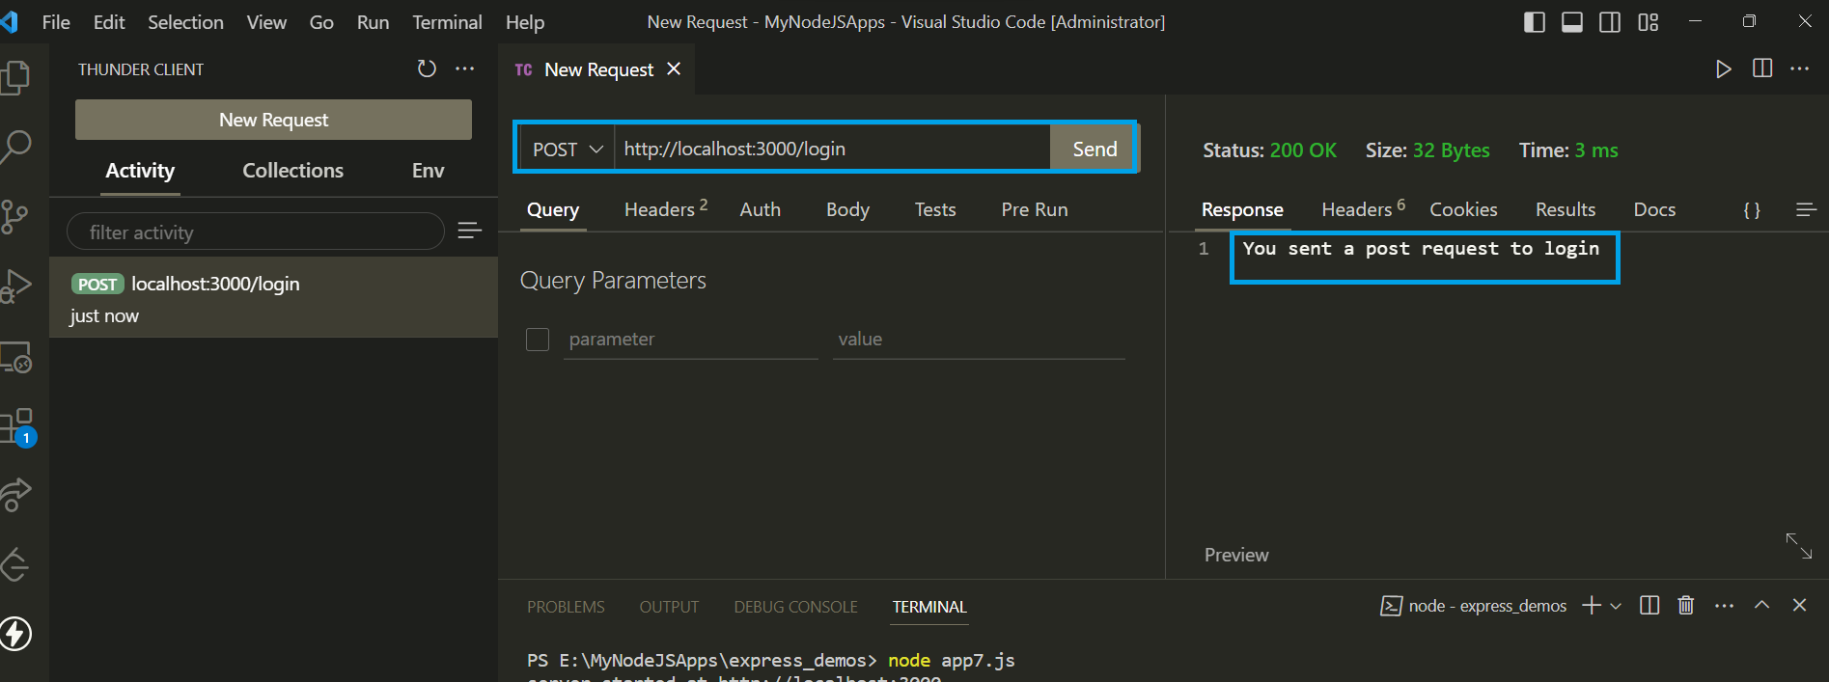
Using thunderclient

Slide 21
Extracting post data
HTTP POST requests are different from GET requests because they contain data in the HTTP request body.
Express doesn't parse HTTP request bodies by default, but it does have a built-in middleware that populates the req.body object with the parsed request body.

Slide 22
Extracting post data
For example:
app.use(express.json())
The above code informs Express to automatically parse the JSON request bodies for us.

Slide 23
Exercise 42
WA Server to modify the product app we discussed earlier to handle the post requests for receiving a product and printing its details on the console.
Also send back a product received message to the client.
The product will be passed as a JSON object through POSTMAN/THUNDERCLIENT containing id, name and price fields

Slide 24
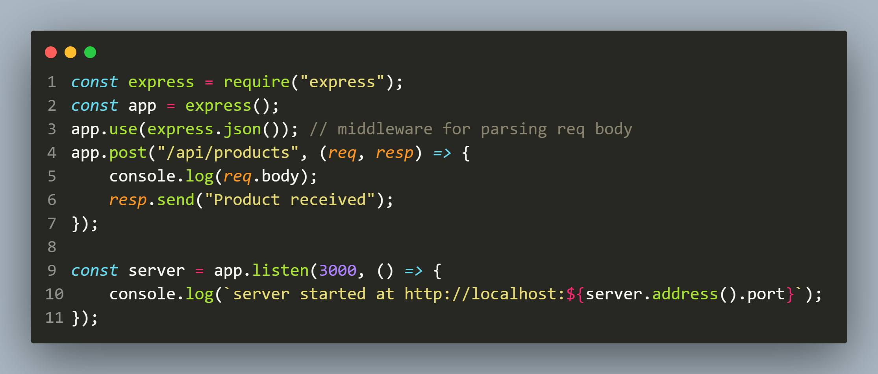
Solution
The code

Slide 25
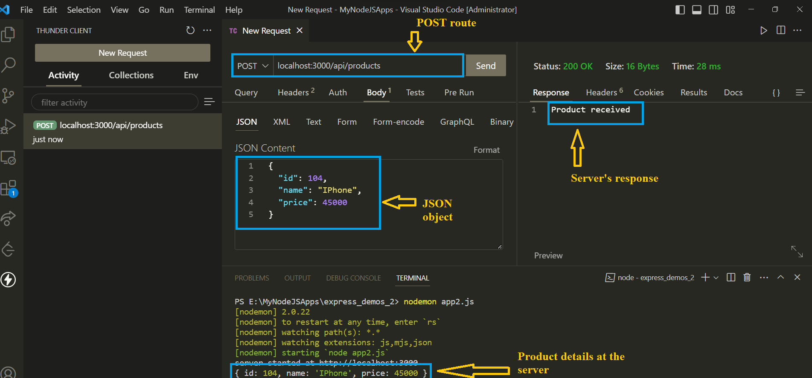
output

Slide 26
Exercise 43
WA Server to modify the previous app for adding new product as follows:
Your application should accept product name and price through a POST request and add the new product to the products array.
Finally it should return a JSON object containing the message product added along with the new id of the product

Slide 27
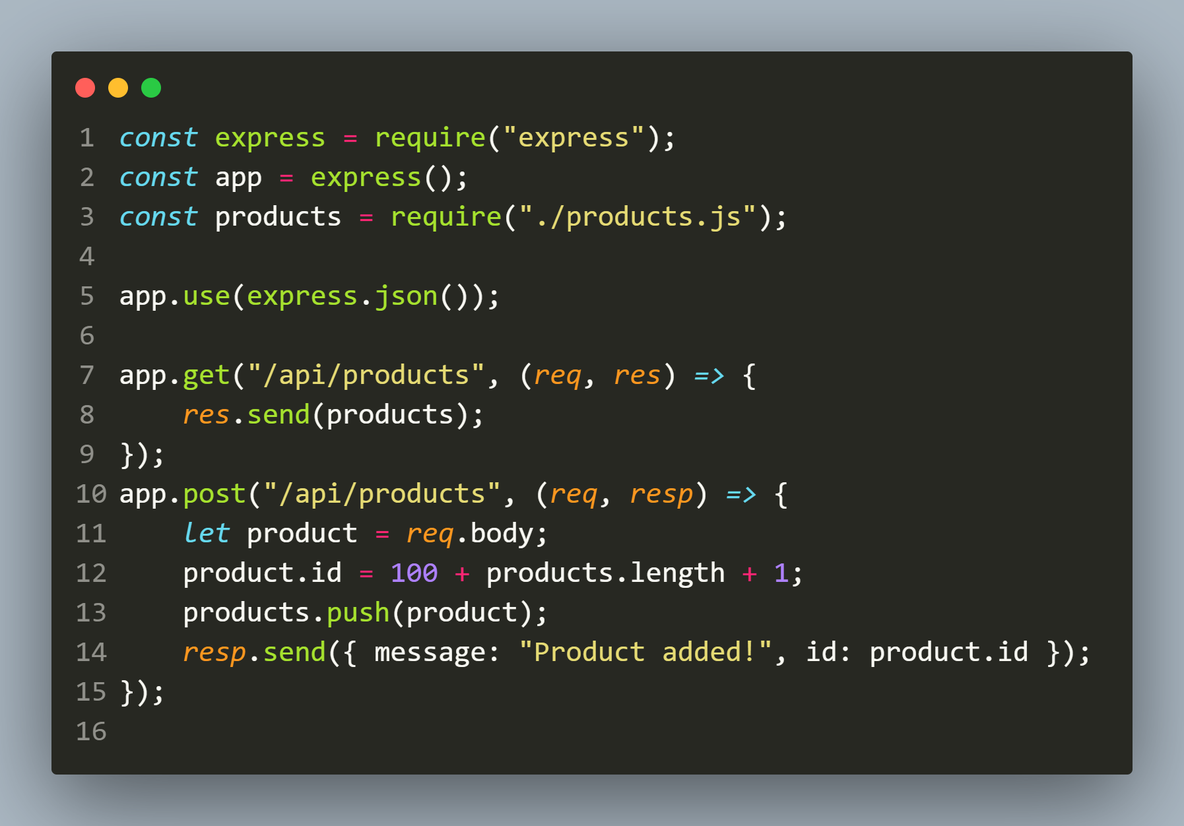
Solution
The code

Slide 28
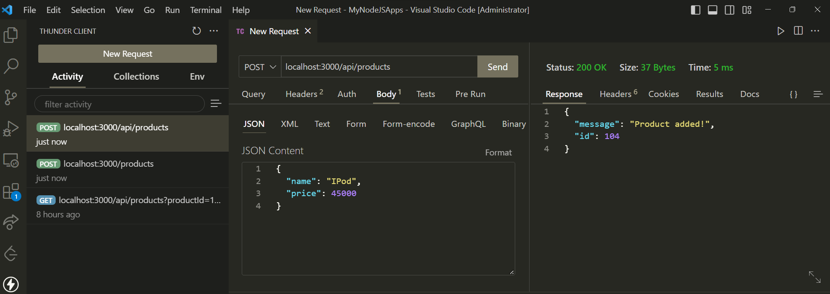
output

Slide 29
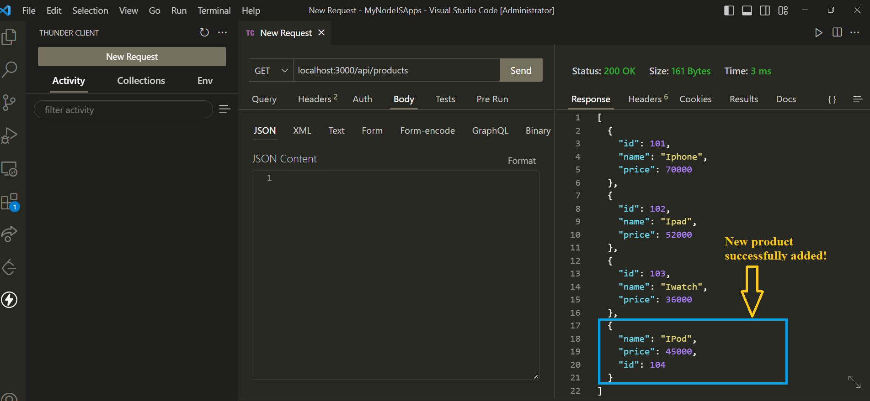
output

Slide 30
Performing validation
We cannot trust that the client will always send valid data.
So before we process the data we must validate it and if the validation fails we must return appropriate error message to the client .
For this purpose the Node.js platform has a special 3rd party module called Joi .

Slide 31
About Joi
Joi module is a popular module for data validation.
This module validates the data based on schemas.
There are various functions like optional(), required(), min(), max(), etc which makes it a user-friendly module for validating the data.

Slide 32
Steps required
Perform an npm install of joi.
Import “joi” using require()
This will return a class
Create a schema object by calling its static method called Joi.object() passing it required types and constraints.

Slide 33
Steps required
Call the validate() method using schema object passing it the object to be validated .
It will return a result object which will contain a property called error if the validation fails otherwise this property will not be present .
The error property itself is an object that holds an array of objects called details with a property called message containing exact error message

Slide 34
Exercise 44
Modify the previous app for adding new product by adding following validations using Joi :
name must be a string with atleast 3 characters and it is a required property
price must be an integer with minimum value of 20000 and it is also a required property
If validation fails then return the error message generated by Joi otherwise if validation passes it should return a JSON object containing the message product added along with the new id of the product

Slide 35
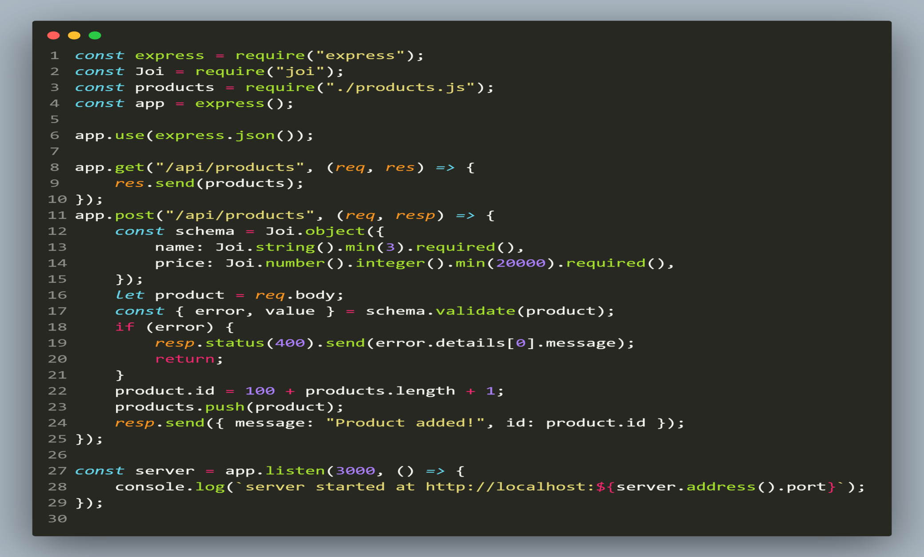
Solution

Slide 36
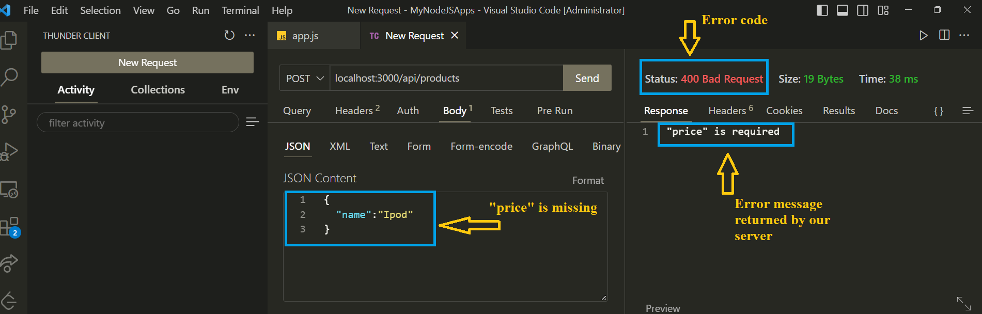
output

Slide 37
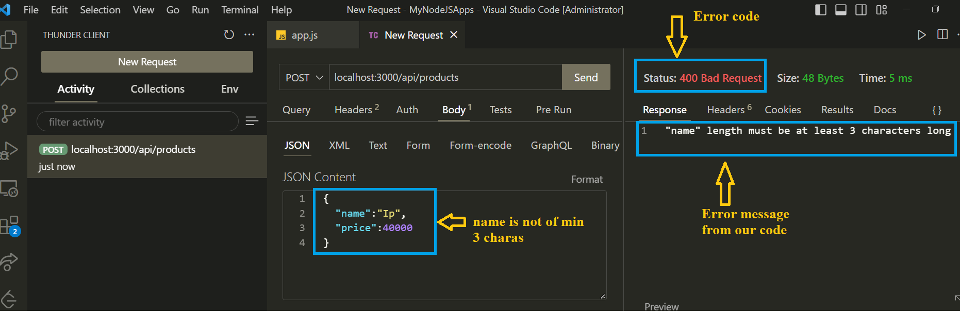
output

Slide 38
Handling put request in express
The PUT request is handled in Express using the put() method.
This is used to update an existing resource on the server .
This corresponds to the Update of crud in a rest api

Slide 39
Exercise 45
WA Server to modify the product app we discussed earlier to handle the put requests for receiving a product and updating it after performing all validations.
Also send back the updated product to the client.
The product will be passed as a JSON object through POSTMAN/THUNDERCLIENT containing name and price fields and id will be passed as route parameter .

Slide 40
Exercise 45
Validations needed are:
name must be a string with atleast 3 characters and it is a required property
price must be an integer with minimum value of 20000 and it is also a required property

Slide 41
Steps needed
Look up the product in the products array .
If it is not found, return a 404 error .
Validate the data being sent to the server .
If that data is invalid, send an error 400 bad request .
If all checks out, then update the product .
Send the updated product back as a response .

Slide 42
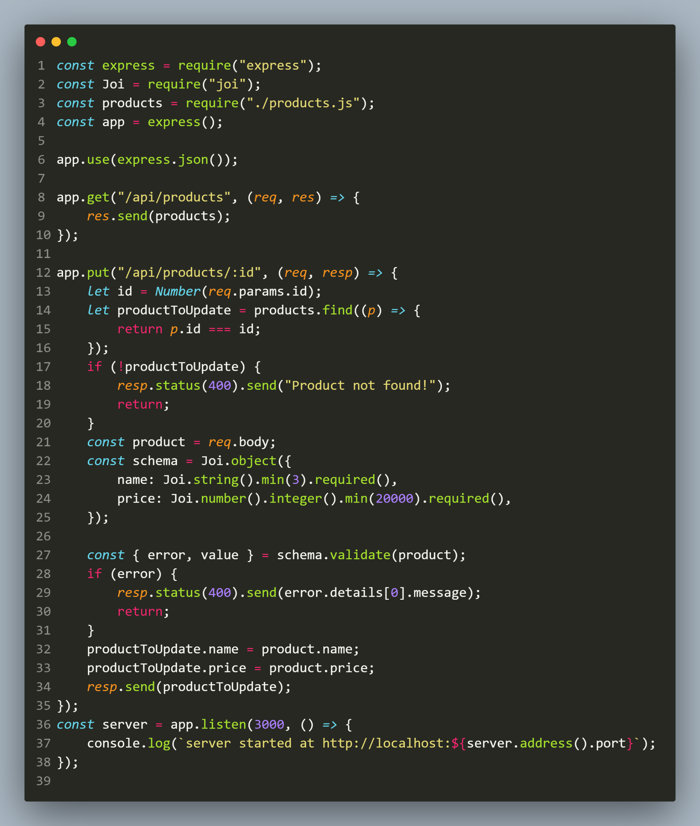
Solution

Slide 43
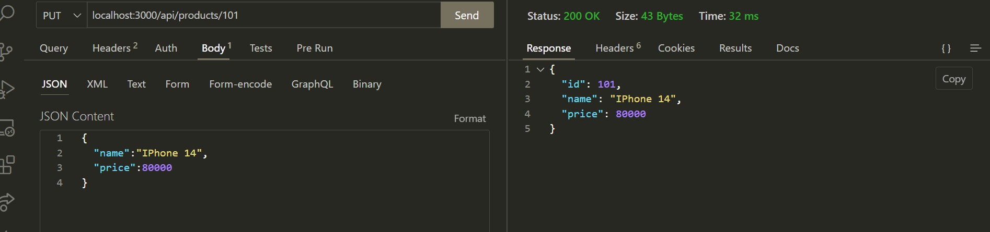
output

Slide 44
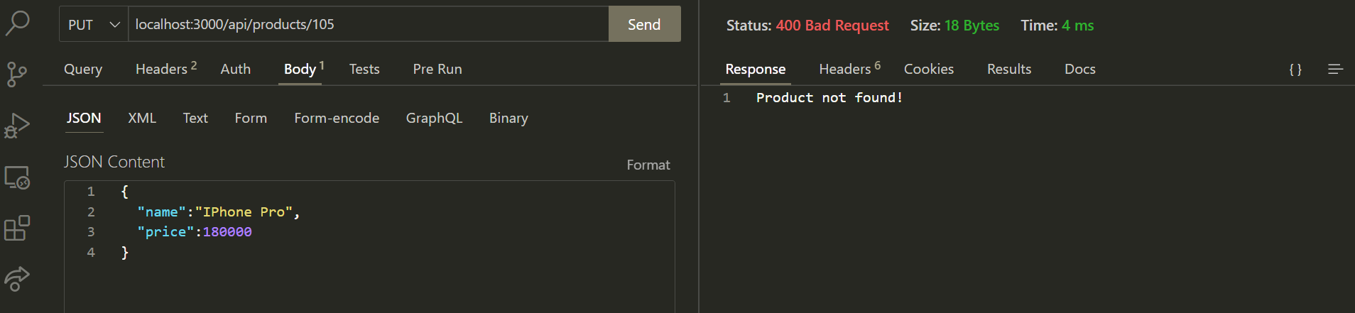
output

Slide 45
Handling delete request
The DELETE request is handled in Express using the delete() method.
This is used to remove an existing resource from the server .
This corresponds to the Delete of crud in a rest api

Slide 46
Exercise 46
WA Server to modify the product app we discussed earlier to handle the delete requests for receiving a product id and removing it
Also send back the deleted product to the client.

Slide 47
Steps needed
Look up the product in the products array .
If it is not found, return a 404 error .
If found, then delete the product .
Send the deleted product back as a response .

Slide 48
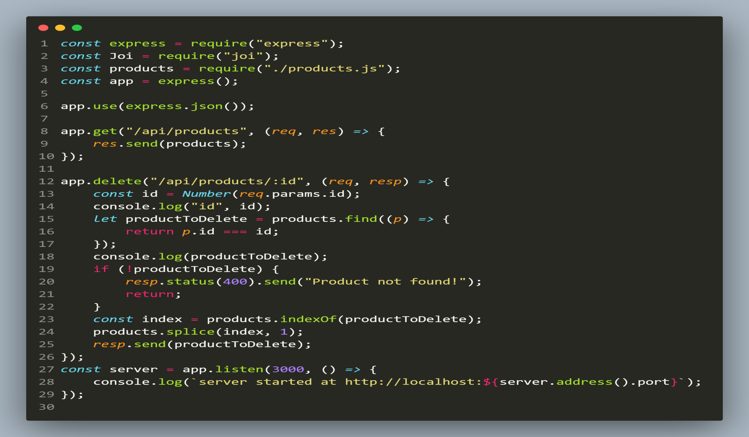
Solution

Slide 49
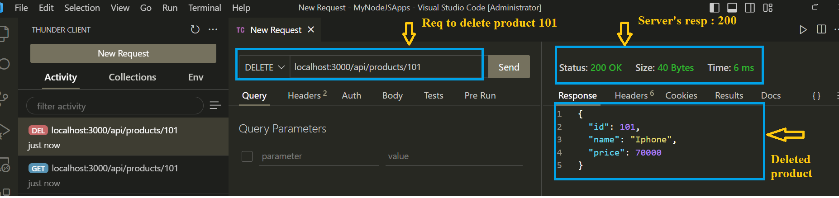
output

Slide 50
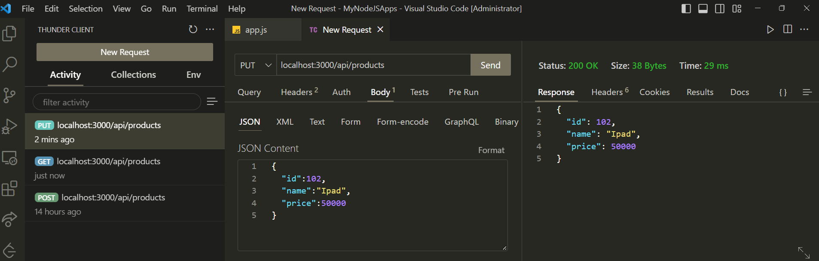
output

Slide 51
Project-5
Develop a RESTful API app for a blogging website.
Following are the tasks this app will perform:
On first execution it should create a folder called data having a file called posts.json with a default post as shown below:
{"id":1,
"title":"HTML",
"url":"http://someurl.com",
"description":"The best"}

Slide 52
Project-5
It should provide API for the client to:
GET all the posts
GET a post by id
Create a new POST
UPDATE a POST based upon id
DELETE a POST based upon id
All the changes done by the app must get reflected in the file posts.json

